Slide 1


CSB4301 – Theory of Computation
B.Tech – IVth Semester
ε NFA to DFA Conversion
Mr. D.S.John Deva Prasanna AP(SG) & Ms.Vanathi, AP,CSE
Department of Computer Science and Engineering

Slide 2
Converting a ε NFA into DFA
We have seen for any given language there exists a DFA, a NFA as well as a ε NFA.
In this session we are going to convert NFA to DFA.
The DFA derived from the NFA will accept the same Language as the NFA (i.e same set of Strings).
In this case we say NFA and DFA are equivalent.

Slide 3
Subset Construction Method
Consider
E=(Q_{E},∑,δ,q0, F_{E}) is a NFA which accepts the language L(N)
D=(Q_{D},∑,δ,{q0}, F_{D}) is a DFA which accepts the language L(D)
The conversion attempts to derive DFA from NFA so that L(N)=L(D).
Input alphabet of both the automata is same.
The start state of DFA is the set of states obtained by finidng eclose(q0).
Not all the states are reachable from the starting; and these states can be removed from the automata

Slide 4
Subset Construction Method e NFA to DFA
The other components are constructed as follows
Q_{D} is the subset of Q_{E} i.e Q_{D} , here the accessible states of D are nothing but the eclosed subsets of, that is S C Q_{E} such that S is eclose(s).
q_{D} = eclose(q0) the starting state of D is the epsilon closure of the starting state of E NFA.
F_{D} is a subset of Q_{E} which contains at least one state from E.
Mathematically F_{D} is a subset S of Q_{E} such that S Ո F_{E} ≠ φ

Slide 5


Compute
δ_{D}(S,a) is computer for all ‘a’ in ∑ and set ‘S’ in Q_{D} as follows
Let S={p1,p2,..pk}
Compute
Let the result of above equation be {r1,r2,..rm}
Then δ_{D}(S,a)=

Slide 6
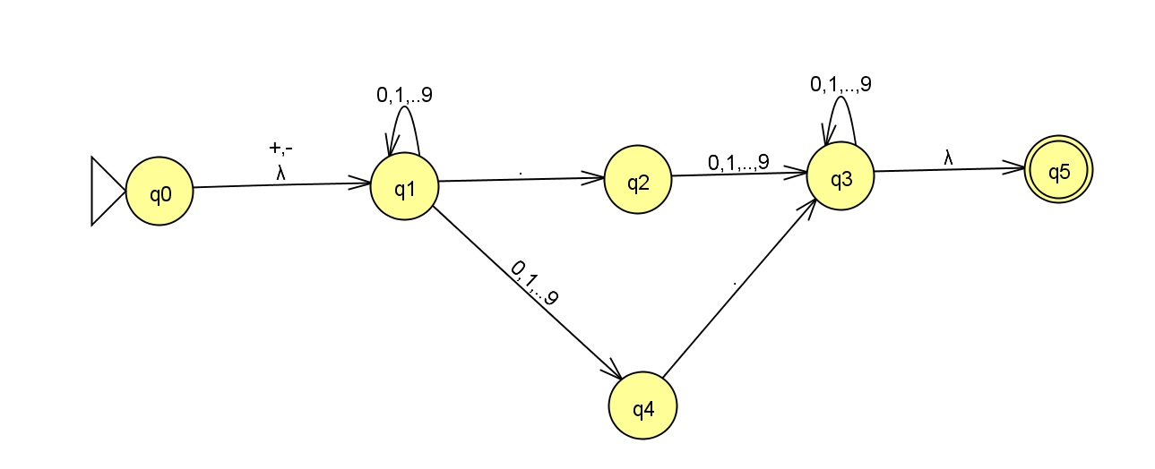
E-NFA which is to be converted into a DFA

Slide 7
Thank You

